Slide 1
Filling Starting Positions
BY:
Shaunessy Reynolds
Aidan Stoner
Gabriel Olszewski

Slide 2
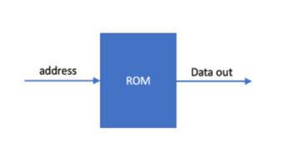
Start ROM
The start ROM module takes in an address and based on that address outputs either a row or column value for the start locations
Inside the ROM is laid out like the following:
Number of start locations
Row of start location 1
Column of start location 1
Row of start location 2
Column of start location 2
Etc.

Slide 3
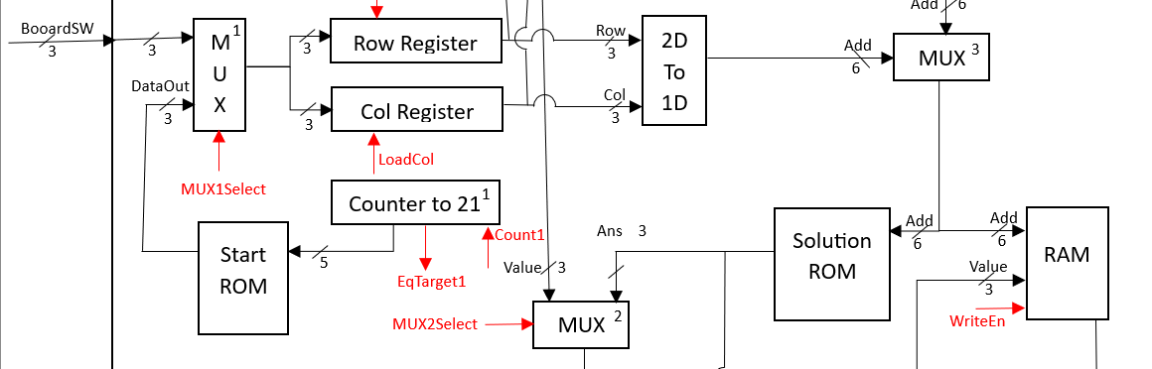
Data Path
The MUX selects the Start ROM module
This module sends a value to the row and column register based on the address from counter2
Then the row and column values are converted in the 2D to 1D
This value is saved in the RAM when the next MUX selects the 2D to 1D value

Slide 4
FSM States
Start Game:
Just a state used as a starting point for the game
Increase Counts:
Two states that both add one to the count of counter1
Load Row:
Saves the row into the row register so that it can be used in the address
Load Col:
Saves the column into the column register so that it can be used in the address
Write to RAM:
MUX2 selects the RAM input to be the solution ROM and uses the address we saved in the row and column registers
That process is then looped through until all the start locations are saved into RAM

Slide 5
FSM
Start Game
Increase Count
count1 = 1
Save Row
LoadRow = 1
Mux1Sel = 1
Write To Ram
Mux2Sel = 1
WriteEn = 1
Save Column
LoadCol = 1
Mux1Sel = 1
Increase Count
count1 = 1
EqTarget = 1

Slide 6
Code (ROM Module)
Solution ROM
entity ROM_Start is
Port (address : in std_logic_vector(0 to 4);
dataOut : out std_logic_vector(0 to 2));
end ROM_Start;
architecture Behavioral of ROM_Start is
type ROM_type is array(0 to 20) of std_logic_vector(0 to 2);
signal ROMarray : ROM_type := ("010",
"000", "010",
"000", "101",
"001", "000",
"010", "000",
"010", "101",
"011", "000",
"011", "100",
"101", "010",
"101", "011",
"101", "101");
-- ^Row ^Col for each start location
begin
dataOut <= ROMarray(to_integer(unsigned(address)));
end Behavioral;

Slide 7
Code (Data Path & FSM next state)
Start ROM in Data Path
StartROM : ROM_Start port map (address => Counter1Out,
dataOut => StartROMout);
Start ROM in FSM
when start =>
nextstate <= increaseCount1;
when increaseCount1 =>
nextstate <= startSaveRow;
when startSaveRow =>
nextstate <= increaseCount2;
when increaseCount2 =>
nextstate <= startSaveCol;
when startSaveCol =>
nextstate <= WriteRAM;
when WriteRAM =>
if FSMeqTarget1 = '1' then
nextstate <= WaitForInput;
else
nextstate <= increaseCount1;
end if;

Slide 8
Code (FSM output)
Start ROM in FSM
when increaseCount1 =>
FSMCount1 <= '1';
when startSaveRow =>
FSMLoadRow <= '1';
FSMmux1Sel <= '1';
when increaseCount2 =>
FSMCount1 <= '1';
when startSaveCol =>
FSMLoadCol <= '1';
FSMmux1Sel <= '1';
when WriteRAM =>
FSMmux2Sel <= '1';
FSMWriteEn <= '1';

